Slide 1



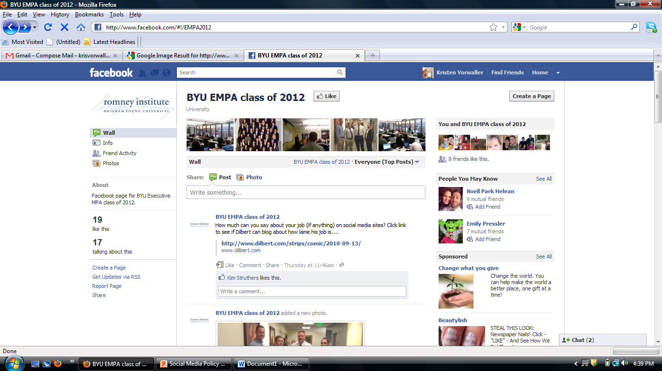

DEVELOPING A SOCIAL MEDIA POLICY FOR YOUR ORGANIZATION
TEAM SEVEN
Kristen Vorwaller
Sue Mortensen
Adam Cowie
Randy Tucker
Ben Hayes

Slide 2
Goals And Expectations
Assist You in Forming Social Media Policy for Your Organization
Articulate the purpose for creating a social media policy
Understand the elements of an effective policy
Stay current with legal issues and comprehend the risks
Determine implementation strategies
Develop Your Organization’s Policy for Social Media
Intro
Development
Legalities
Implementation
Conclusion
Notes:
Training Goal: “Assist you, as managers, in forming social media policy for your organization”
Performance (What we expect you to learn from the training): “By the end of this session, you will be able to ….. (bullet points)”
Test (How will we know if the training is successful?): “You go back to your organization and initiate the development of Your Organization’s…..”

Slide 3

Types of Social Media
Collaborative Projects (Wikipedia)
Social Networking (Facebook, Linked-In)
Blogs & Microblogs (Twitter)
Content Communities (YouTube)
Virtual Social Worlds (Second Life)
Virtual Game Worlds (World of Warcraft)
Intro
Development
Legalities
Implementation
Conclusion
Notes:
Multiple types of social media – focus on one or two that best promote company and don’t stretch staff or resources too thin.

Slide 4

Utilization of Social Media
A 2011 survey found that 47% of American adults use a social network.
Marketing/PR
Social Interaction
Networking
Communication
Intro
Development
Legalities
Implementation
Conclusion
Notes:
Removed the hyperlink from the bottom of the page:
http://finance.yahoo.com/family-home/article/112952/family-that-tweets-wsj?mod=family-kids_parents

Slide 5

PURPOSE
Social Media Policy
Define Your Organization
Establish Role of Social Media
Articulate Policy
Dev
Introduction
Legalities
Implementation
Conclusion
Notes:
Define Organization: vision statement and mission of org.
Role: why use social media? what purpose does your site serve? How will that purpose affect the policy you create?
Articulate policy: go into specifics of policy. Living document – has ability to change with technology.

Slide 6






POLICY ELEMENTS
Social Media Policy
Structure
  Think Global
  Think Instant
  Think Permanent
Visual Structure
Authorization and Access
Existing Policies
Responsibilities / Expectations
Dev
Introduction
Legalities
Implementation
Conclusion

Slide 7

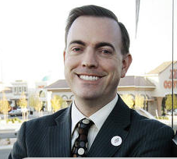

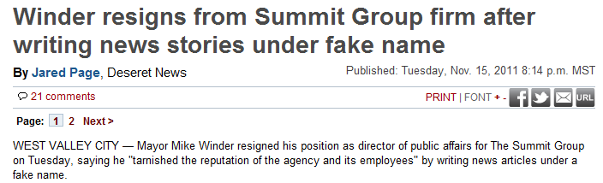
POLICY ELEMENTS
Social Media Policy
Transparency
Who are you?
Who do you represent?
Agent vs. Personal
Legal Disclaimer
Dev
Introduction
Legalities
Implementation
Conclusion
Notes:
Mayor Mike Winder – had over 10 articles printed as Deseret News reporter under fake name, fake address, fake phone, and fake picture. Resigned from employment and brought impression of mistrust to West Valley City.

Slide 8


POLICY ELEMENTS
Social Media Policy
Professionalism
Polite, Respectful, Positive
Mother/Grandma/Boss filter
Describe what’s inappropriate
Be specific! (pornography, sexually suggestive, profanity, etc.)
Confidential and Proprietary Information
Dev
Introduction
Legalities
Implementation
Conclusion
Notes:
- Picture of Adam’s mom and 90 yr old grandma. If you would be embarrassed if your mother, grandma, or boss saw something you posted, then DON’T post it!
- Protect client, customer, and company information.

Slide 9

Social Media Trends
Restrictive Policies
Discipline / Dismissal
Prohibit Social Media
Resulting from Social Media use
Restrict
Policy Restricts Section 7 of NLRA Provisions
Legal
Introduction
Development
Implementation
Conclusion

Slide 10

Violations to Avoid
Discriminating against a protected class
Violating Expectation of Privacy
Making Unauthorized Access
Violating State and Federal Laws
Legal
Introduction
Development
Implementation
Conclusion

Slide 11

Social Media Case Law
NLRA – Primary jurisdiction over labor policies & disputes
  Government exempted
NLRB vs American Medical Response, 2010
NLRB is creating a social media policy
Legal
Introduction
Development
Implementation
Conclusion

Slide 12

Building Awareness
  Training Workshops or Presentations
  New Employee Orientation
Social Media Policy
What to include in Training
  Ensure the Policy is Available
  Purpose of Instituting it at this Time
  Who the Policy Applies to
  Benefits and Dangers
Implement
Introduction
Development
Legalities
Conclusion
Notes:
http://www.slideshare.net/ghostvertizer/5-steps-to-implement-a-social-media-policy

Slide 13

Enforcement
Equitable Enforcement
Types of Monitoring
  Internal
  Third-party
Social Media Policy
Promptness of Investigating
Considerations before Taking Action
Reviewing and Updating the Policy
Implement
Introduction
Development
Legalities
Conclusion
Notes:
http://hr.blr.com/HR-news/HR-Administration/Electronic-Monitoring/11zbb01-How-Do-You-Enforce-Social-Media-Policies-/

Slide 14

Conclusion
Remember to join the EMPA Class of 2012 Facebook Page!
www.facebook.com/EMPA2012
Conclusion
Introduction
Development
Legalities
Implementation

Slide 15
References
http://finance.yahoo.com/family-home/article/112952/family-that-tweets-wsj?mod=family-kids_parents
  http://www.slideshare.net/ghostvertizer/5-steps-to-implement-a-social-media-policy
  http://hr.blr.com/HR-news/HR-Administration/Electronic-Monitoring/11zbb01-How-Do-You-Enforce-Social-Media-Policies-/
Conclusion
Introduction
Development
Legalities
Implementation

